Slide 1
Analog and Digital Electronic Lab Subject Code:18csl37
Design and Implement Half adder, Full adder, Half substractor, Full substractor using basic gates and implement the same in HDL.

Slide 2
Introduction
Adder
Half adder
Full adder
Subtractor
Half Subtractor
Full Subtractor

Slide 3
Adder
An adder is a combinational logic circuit in electronics that implements addition of numbers.
In many computers and other kinds of processors, adders are used not only in
the arithmetic logic units, but also in other parts of the processor, where they are used to calculate addresses, increment and decrement operators, and similar operations.
Adders are classified into two types:
half adder.
full adder

Slide 4
Adder
Let us first take a look at the addition of single bits.
0+0 = 0
0+1 = 1
1+0 = 1
1+1 =10 (i.e. 1+1=0 with carry = 1)

Slide 5
Half Adder
The half adder adds two single binary digits A and B.
It has two outputs, sum (S) and carry (C).
The carry signal represents an overflow into the next digit of a multi-digit addition.
Truth Table
INPUTS
OUTPUTS
A | B | SUM | CARRY
0 | 0 | 0 | 0
0 | 1 | 1 | 0
1 | 0 | 1 | 0
1 | 1 | 0 | 1

Slide 6
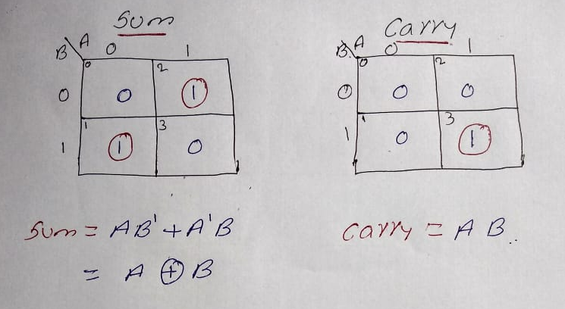
Solving truth table using K-map

Slide 7
Analyzing results
No of inputs = 2
No of outputs = 2
Inputs are A , B.
Outputs are Sum , Carry.
Sum can be obtained using XOR logic gate.
Carry can be obtained using AND logic gate

Slide 8
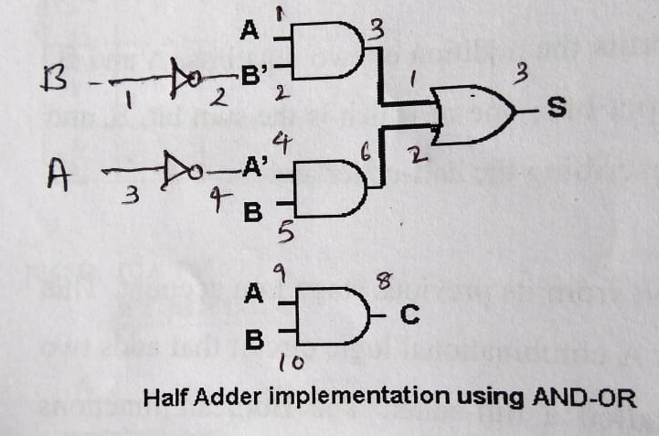
Half adder circuit diagram

Slide 9
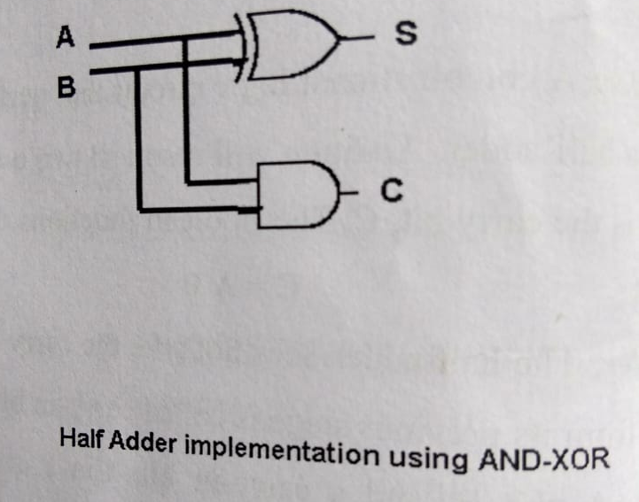
Half adder circuit diagram

Slide 10
Full Adder
A full adder adds binary numbers and accounts for values carried in as well as out.
The main difference between a half-adder and a full adder is that the full-adder has three inputs and two outputs.
A one-bit full adder adds three one-bit numbers, often written as A, B, and C_{in.}
It has two outputs, sum (S) and carry (C).

Slide 11
Truth Table for Full Adder
INPUTS
OUTPUTS
A | B | CIN | C | Sum
0 | 0 | 0 | 0 | 0
0 | 0 | 1 | 0 | 1
0 | 1 | 0 | 0 | 1
0 | 1 | 1 | 1 | 0
1 | 0 | 0 | 0 | 1
1 | 0 | 1 | 1 | 0
1 | 1 | 0 | 1 | 0
1 | 1 | 1 | 1 | 1

Slide 12
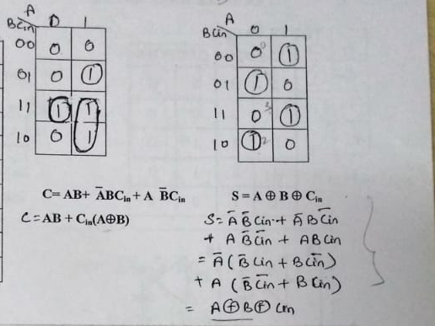
Solving truth table using K-map for full adder

Slide 13
Subtractor
An Subtractor is a digital logic circuit in electronics that implements subtraction of numbers.
In many computers and other kinds of processors, Subtractor are used not only in the arithmetic logic units, but also in other parts of the processor, where they are used to calculate addresses, increment and decrement operators, and similar operations.
Substractor are classified into two types:
1)half Subtractor. 2) full Subtractor.

Slide 14
Subtractor
Let us first take a look at the subtraction of single bits.
0-0 = 0
0-1 = 11 (i.e. 0-1 = 1 with borrow = 1)
1-0 = 1
1-1 = 0

Slide 15
Half Subtractor
The half Subtractor subtracts two single binary digits A and B.
It has two outputs, Difference (D) and borrow (B).
The borrow signal represents an overflow into the next digit of a multi-digit subtraction

Slide 16
Truth Table for Half Subtractor
INPUTS
OUTPUTS
A | B | DIFF | BORROW
0 | 0 | 0 | 0
0 | 1 | 1 | 1
1 | 0 | 1 | 0
1 | 1 | 0 | 0

Slide 17
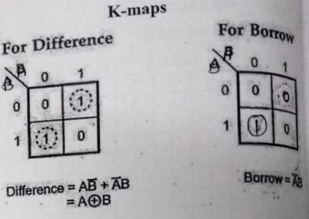
Solving truth table using K-map for Half Subtractor

Slide 18
Analysing results
No of inputs = 2
No of outputs = 2
Inputs are A , B.
Outputs are Difference , Borrow.
Difference can be obtained using XOR logic gate.
Borrow can be obtained using NOT and AND logic gate

Slide 19
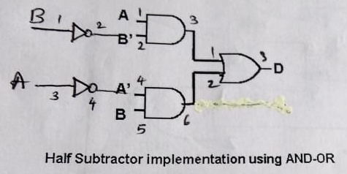
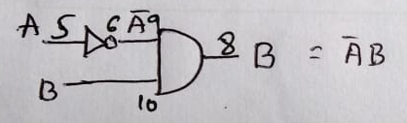
Half Subtractor circuit diagram

Slide 20
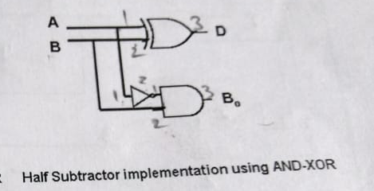
Half Subtractor circuit diagram using EX-OR

Slide 21
Full Subtractor
A full Subtractor subtracts binary numbers and accounts for values borrowed in as well as out.
The main difference between a half- Subtractor and a full- Subtractor is that the full-Subtractor has three inputs and two outputs.
A one-bit full Subtractor subtracts three one-bit numbers, often written as A, B, and B_{in.}
It has two outputs, Difference (D) and borrow (B).

Slide 22
Truth Table Full Subtractor
INPUTS
OUTPUTS
A | B | Cin | Br | D
0 | 0 | 0 | 0 | 0
0 | 0 | 1 | 1 | 1
0 | 1 | 0 | 1 | 1
0 | 1 | 1 | 1 | 0
1 | 0 | 0 | 0 | 1
1 | 0 | 1 | 0 | 0
1 | 1 | 0 | 0 | 0
1 | 1 | 1 | 1 | 1

Slide 23
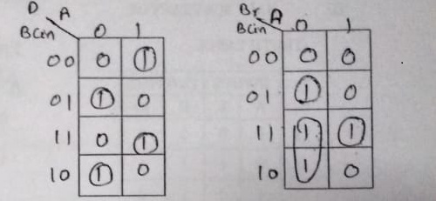
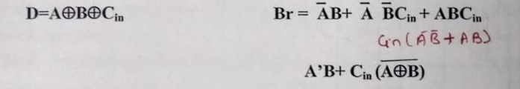
Solving truth table using K-map for Full Subtractor

Slide 24
VHDL
A hardware description language allows a digital system to be designed debugged at a higher-level before implementation at the gate level.
The two most popular hardware description languages are VHDL and Verilog.
VHDL | Verilog
ADE based | C-based
More powerfull | Less
Difficult to learn | easy

Slide 25
VHDL
VHDL can describe a digital system at several different levels -Behavioral level
-Dataflow level
-Structural level
Behavioral level in terms of its function of adding two binary numbers without giving any implementation details.
Dataflow level- by giving the logic equations.
Structural level- by specifying the inter-connections of the gates which makeup the adder.
Notes:
B

Slide 26
Xilinx
Xilinx ISE (Integrated Synthesis Environment) is a software tool produced by Xilinx for synthesis and analysis of HDL designs, enabling the developer to synthesize ("compile") their designs, perform timing analysis simulate a design's reaction to different stimuli, and configure the target device with the programmer.

Slide 27
Thank you

